Slide 1
Data partitioning for large scale gpu algorithms
Kristi Belcher

Slide 2
Outline
Project goals
Algorithms
Experiments
Results
Conclusions

Slide 3
My project
For each algorithm:
Base: version where all data is sent at once to the GPU
Partitioned: version where data is partitioned and sent in groups to the GPU
Optimizations
Comparison of results
Analysis

Slide 4
My project
Goals:
To show a proof of concept for my PhD research
To get an idea of potential setbacks I’ll have
To get warmed up for this kind of thinking

Slide 5
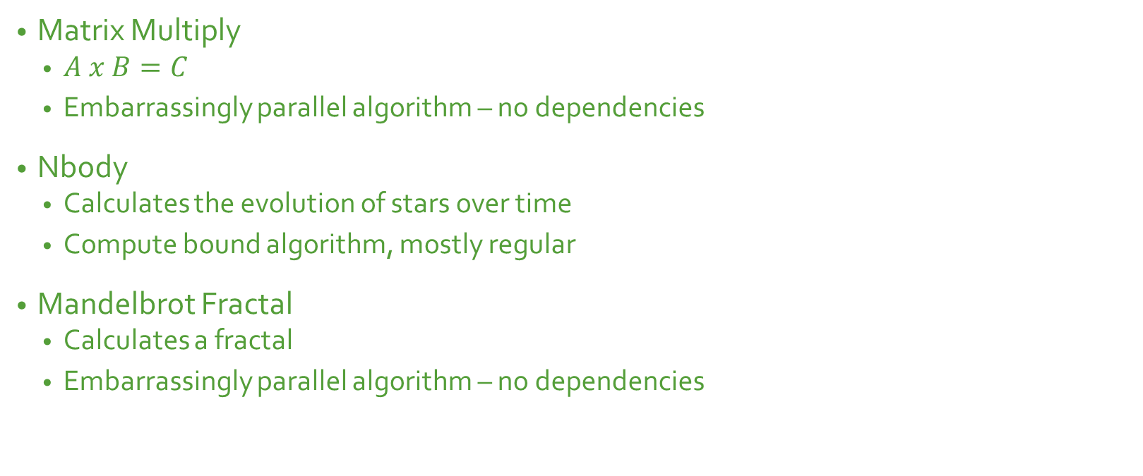
Algorithms
Matrix Multiply
$A x B=C$
Embarrassingly parallel algorithm – no dependencies
Nbody
Calculates the evolution of stars over time
Compute bound algorithm, mostly regular
Mandelbrot Fractal
Calculates a fractal
Embarrassingly parallel algorithm – no dependencies

Slide 6
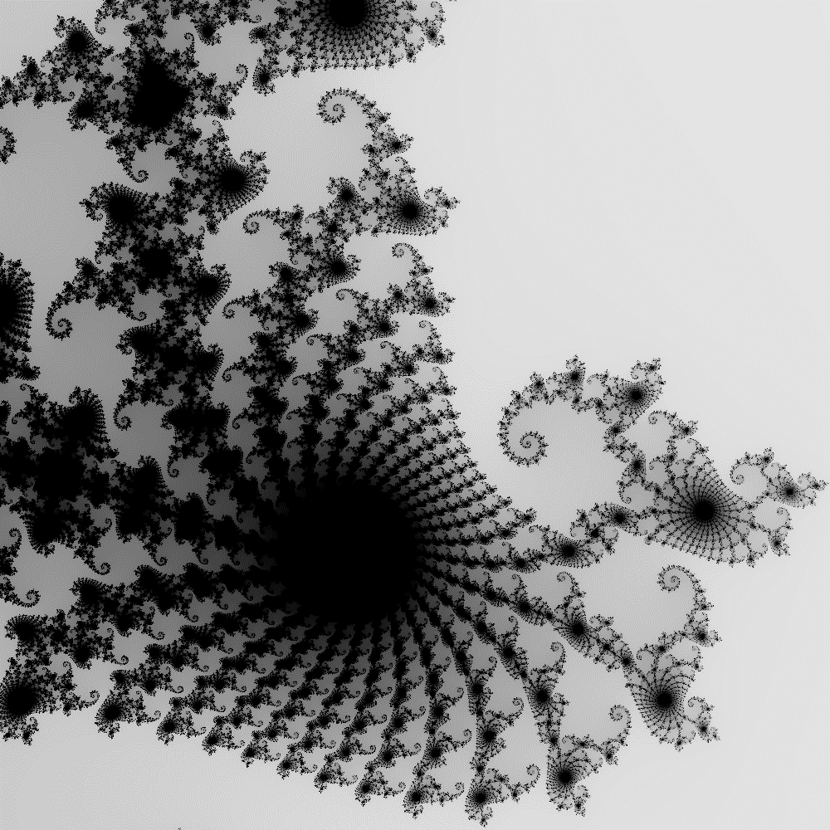
Fractal

Slide 7
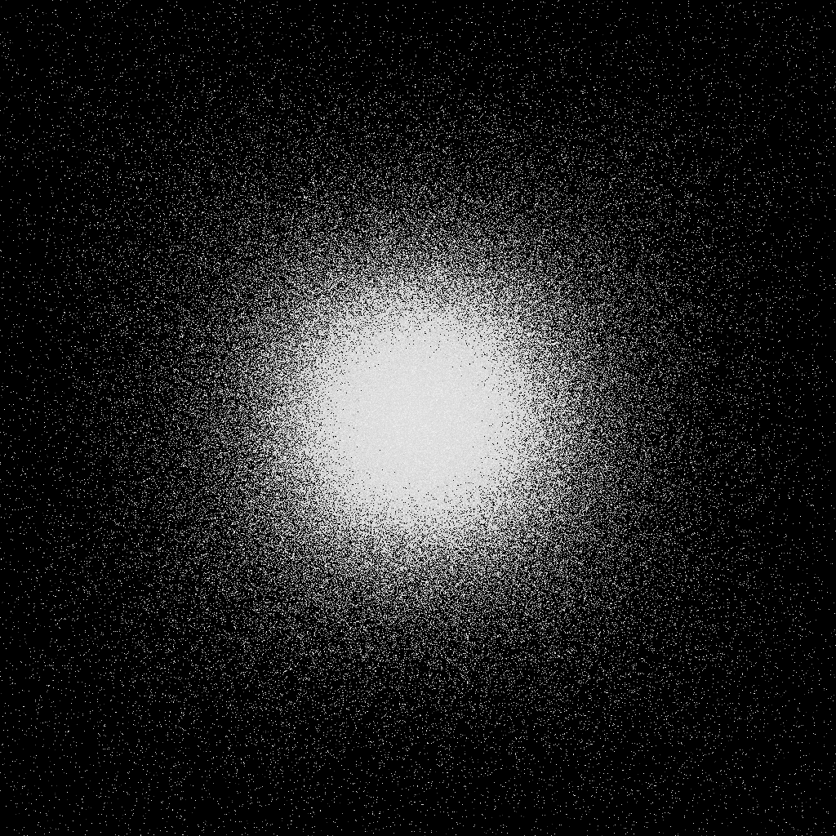
Nbody - demo
200k bodies, 10 timesteps

Slide 8
Experiments
Only GTX 1070 results presented here
Ran experiments on NVIDIA GeForce GTX 1070 and Tesla K40c
Nbody:
Used increasing numbers of bodies starting at 100k to 1M and 10 timesteps
Experimented with number of timesteps (10, 20, 50, 100)
Tested groups of 2, 5, 10, and 25
Matrix Mult
Experiments went from 100 x 100 to 30,000 x 30,000
Tested groups of 2, 5, 10, and 25
Fractal
Tested a range of different sizes from 1,000 x 1,000 to 10,000 x 10,000
Also experimented with different depth sizes from 128 to 512
Tested groups of 2, 5, 10, and 25
https://www.geforce.com/hardware/desktop-gpus/geforce-gtx-1070/specifications

Slide 9
Experiments
Partitioned the data in uniformly sized groups
Load imbalance not really an issue*
Partitioned the data:
Fractal– relative to the x axis, by number of groups
nBody – divided up total number of bodies by number of groups
Matrix Mult – divided matrix work up by number of groups
Dependency!

Slide 10
Results – Matrix Multiplication
Only hurts performance!

Slide 11
Results – Matrix Multiply

Slide 12

Results – Matrix Multiplication
Too large for Base case!

Slide 13
Results – nbody (bodies)

Slide 14
Results – nBody (timesteps)
Each with 200k bodies

Slide 15
Results – Fractal (width)

Slide 16
Results – Fractal (width)

Slide 17
Results – Fractal (depth)
5000 x 5000 fractal

Slide 18
Analysis – Matrix Multiply
Need to fully load GPU or else there is a performance hit
Partitioning allows larger problem sizes to be computed
Ran out of memory at certain problem sizes, only the partitioned version could proceed
At biggest problem sizes, performance impact of increasing number of groups is negligible
Optimizations:
CUDA streams
Floats, not doubles
Pinned memory
Asynchronous calls
Loop unrolling*

Slide 19
Analysis - nBody
Need to fully load GPU to get performance benefit
More benefit seen at bigger problem sizes
Tricky to reach memory limit
nBody algorithm is compute bound
Saw similar trends whether the number of bodies was varied or the number of timesteps was varied
Optimizations:
CUDA streams
Pinned memory
Register data types
Asynchronous calls

Slide 20
Analysis – Fractal
Any benefit of data partitioning is hidden by the extra communication needed.
Minimal benefit for some problem sizes, but most likely not worth it.
At biggest problem sizes, performance impact of increasing number of groups is negligible
Most of the benefit will be from the ability to compute larger fractals
Once the GPU memory limit has been reached
Similar trends when depth is varied versus when width is varied
Optimizations
Pinned memory
Asynchronous calls
Compiler optimizations

Slide 21
Conclusions
For my research:
Intuition on how to code data partitioned algorithms
Intuition on when to expected performance gains/hits and in what circumstances
Speedups (best overall)
Matrix Multiply: 1.813 (5,000) and 1.82 (10,000)
NBody: 1.25 (bodies) and 1.47 (timesteps)
Fractal: 1.217 (2,000)
There is limited performance benefit
Sweet spot number of groups around 2 or 5, more hurts performance
Again, make sure to fully load GPU (make sure problem size is large enough)
Results vary GPU to GPU – this could be good future work

Slide 22
Thank You
Questions?

